Slide 1
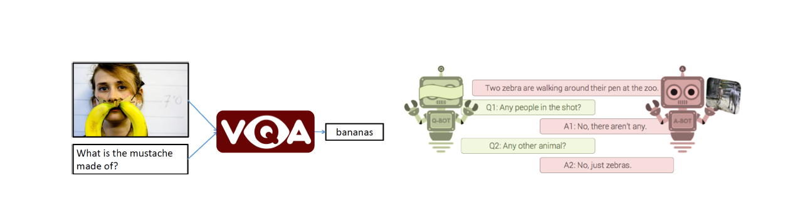
Persian Visual Question Answering
Alireza Asghari
Maryam Sadat Hashemi
Final Project of Deep Learning Course
Spring 2020

Slide 2
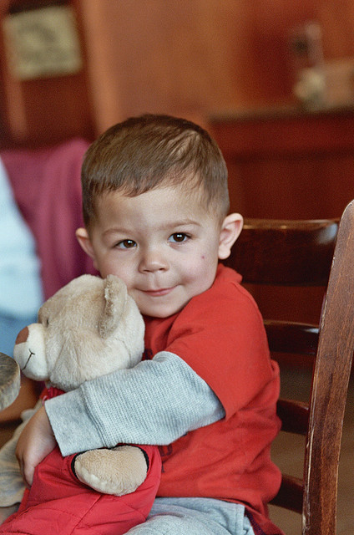
1) VQA Task

Slide 3
1) VQA Task
What color is the
baby's shirt?

Slide 4
1) VQA Task
VQA
System
What color is the
baby's shirt?

Slide 5
1) VQA Task
VQA
System
Red
What color is the
baby's shirt?

Slide 6
1) VQA Task
Persian VQA
System
قرمز
پیراهن کودک چه رنگی است؟

Slide 7

2) VQA Applications
An aid to visually-impaired
or blind persons

Slide 8

2) VQA Applications
An aid to visually-impaired
or blind persons
Interacting with a robot

Slide 9

2) VQA Applications
An aid to visually-impaired
or blind persons
Interacting with a robot
An aid to clinicians to interpret
complex medical images.

Slide 10
3) Dataset
VQA v1 | Image | Questions | Annotations
Train | 82,783 | 248,349 | 2,483,490
Validation | 40,504 | 121,512 | 1,215,120
Test | 81,434 | 244,302 | -

Slide 11


3) Dataset
VQA v1 | Image | Questions | Annotations
Train | 82,783 | 248,349 | 2,483,490
Validation | 40,504 | 121,512 | 1,215,120
Test | 81,434 | 244,302 | -

Slide 12
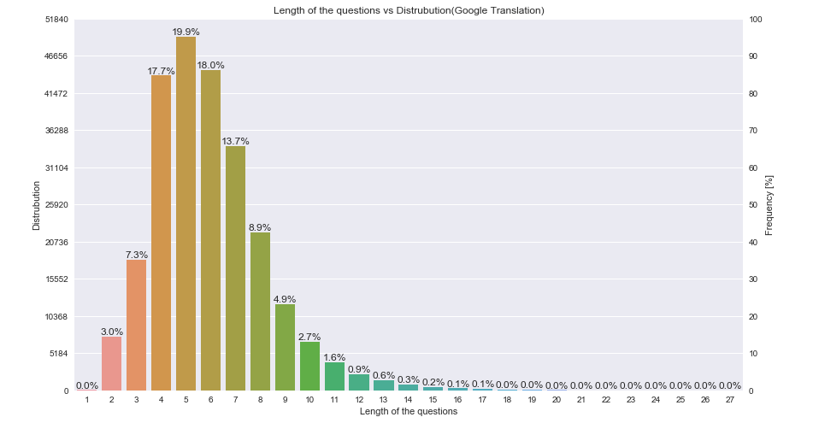
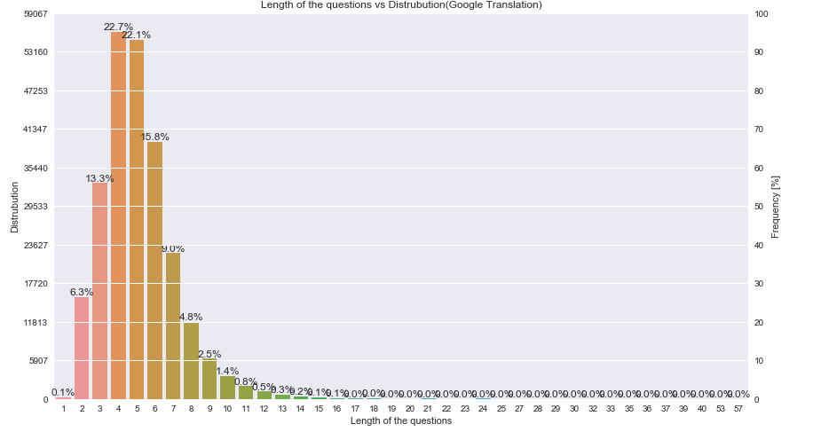
3) Dataset

Slide 13
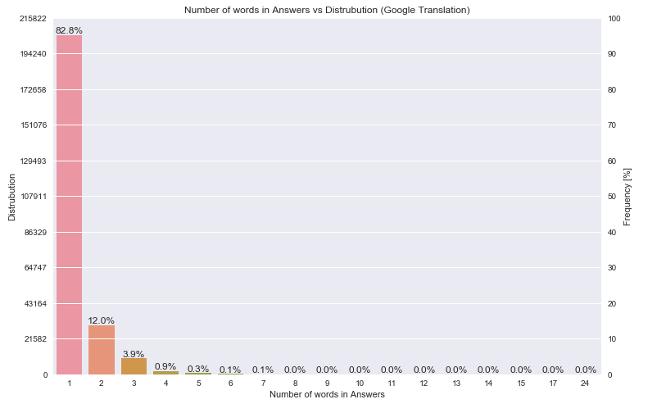
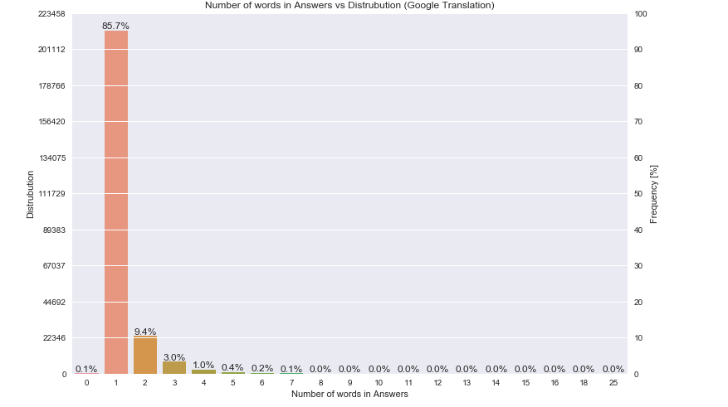
3) Dataset

Slide 14
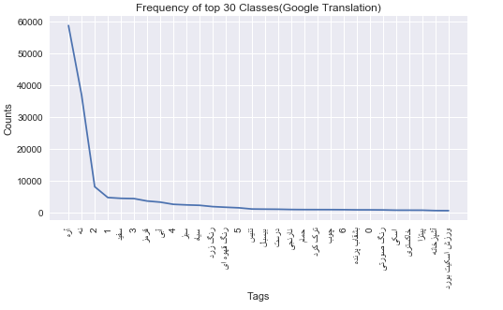
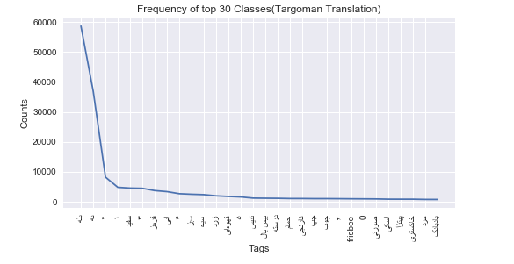
3) Dataset

Slide 15
4) Methods
LSTM Q +norm I
SAN
HieCoAttention

Slide 16
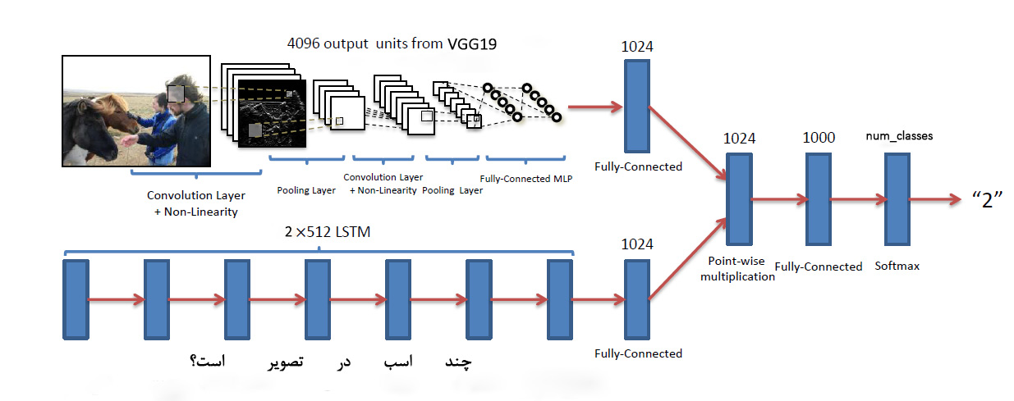
4) LSTM Q + norm I

Slide 17
4) Methods
lstmQ+normI
SAN
HieCoAttention

Slide 18
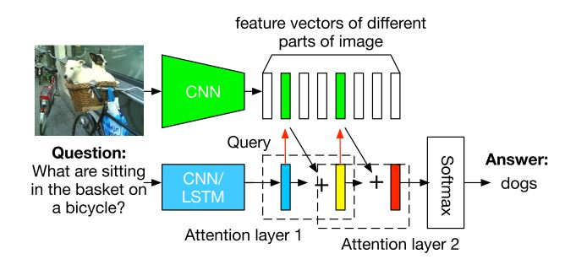
4) SAN

Slide 19
4) Methods
lstmQ+normI
SAN
HieCoAttention

Slide 20
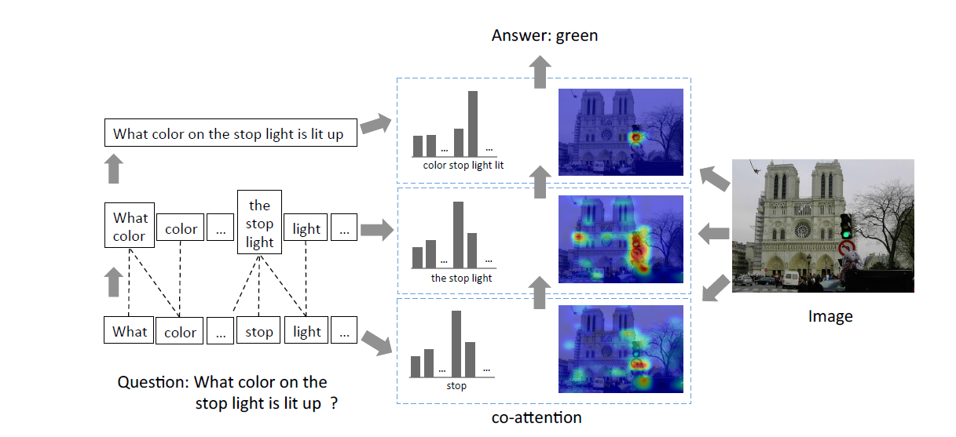
4) HieCoAttention

Slide 21
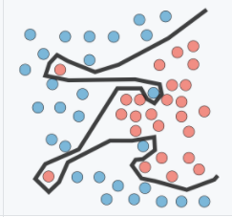

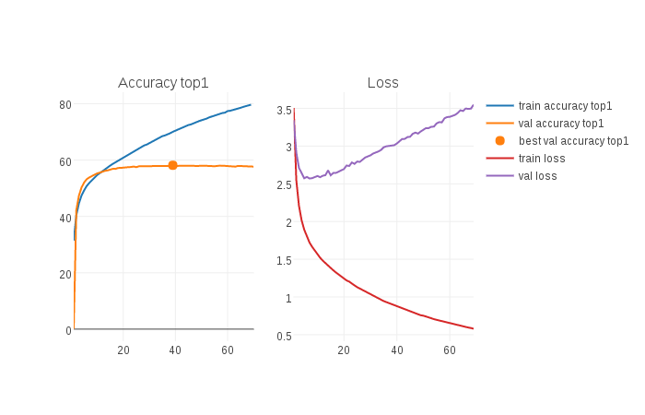
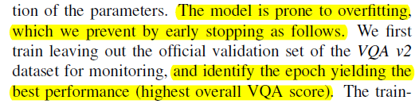
4) Evaluation , overfit? and solution

Slide 22
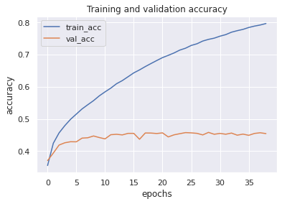
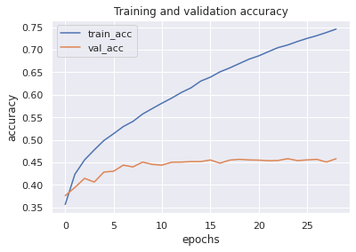
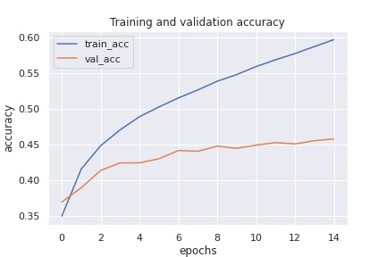


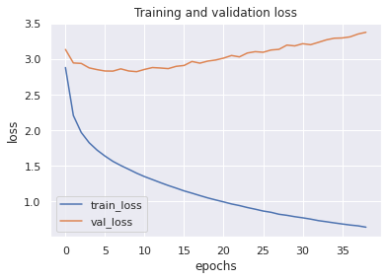
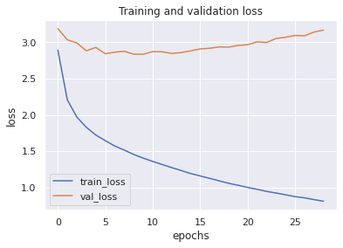
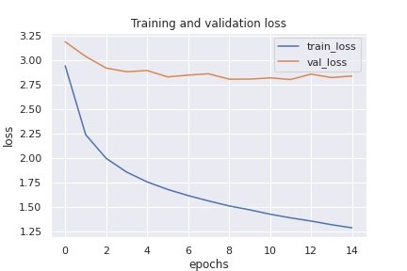
Soft overall acc : 52.90
Patience : 10 ep
Soft overall acc : 52.85
Patience : 5 ep
Hard overall acc : 52.82
Patience : 3 ep

Slide 23
5) Results
All | Other | Num | Y/N | Method
48.07 | 32.47 | 32.41 | 74.18 | Coattention_targoman
49.15 | 33.53 | 32.61 | 75.58 | lstmQ+VGG19(T)
50.53 | 35.78 | 32.97 | 76.14 | lstmQ+VGG19(baseline)
50.81 | 36.82 | 31.61 | 75.95 | SAN_LSTM_2_targoman
51.37 | 37.37 | 32.29 | 76.48 | SAN_CNN_2_Targoman
51.85 | 38.12 | 32.7 | 76.62 | Coattention_google
51.89 | 38.6 | 31.63 | 76.46 | BilstmQ+resNet152
52.13 | 38.77 | 31.75 | 76.83 | lstmQ+resNet152
52.22 | 38.35 | 32.23 | 77.46 | SAN_LSTM_1
52.27 | 38.62 | 32.56 | 77.12 | SAN_LSTM_3_Google
52.58 | 37.99 | 33.7 | 78.43 | lstmQ+VGG19(en-paperToken)
52.76 | 39.18 | 33.17 | 77.49 | SAN_CNN_2_google
52.79 | 38.78 | 31.91 | 78.53 | lstmQ+VGG19 (en-kerasToken)
52.82 | 38.98 | 31.91 | 78.34 | cnnQ+resNet152
52.84 | 39.08 | 33.19 | 77.83 | SAN_LSTM_2_google

Slide 24
5) Results
All | Other | Num | Y/N | Method
50.91 | 36.26 | 31.85 | 76.86 | lstmQ+VGG19(T)
51.3 | 36.98 | 32.5 | 76.74 | lstmQ+VGG19(baseline)
52.9 | 38.99 | 32.36 | 78.38 | cnnQ+resNet152
53.37 | 39.89 | 33 | 78.22 | BilstmQ+resNet152
53.58 | 40.4 | 31.76 | 78.5 | lstmQ+resNet152
53.66 | 39.42 | 33.62 | 79.41 | lstmQ+VGG19 (en-kerasToken)
54.01 | 40.41 | 32.69 | 79.34 | lstmQ+VGG19(en-paperToken)

Slide 25
Demo

Slide 26
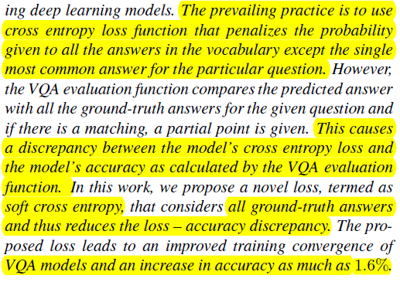
Evaluation protocol
Part of | Total
46+

